Slide 2
Bitter & Better
Mercy & Grace

Slide 3
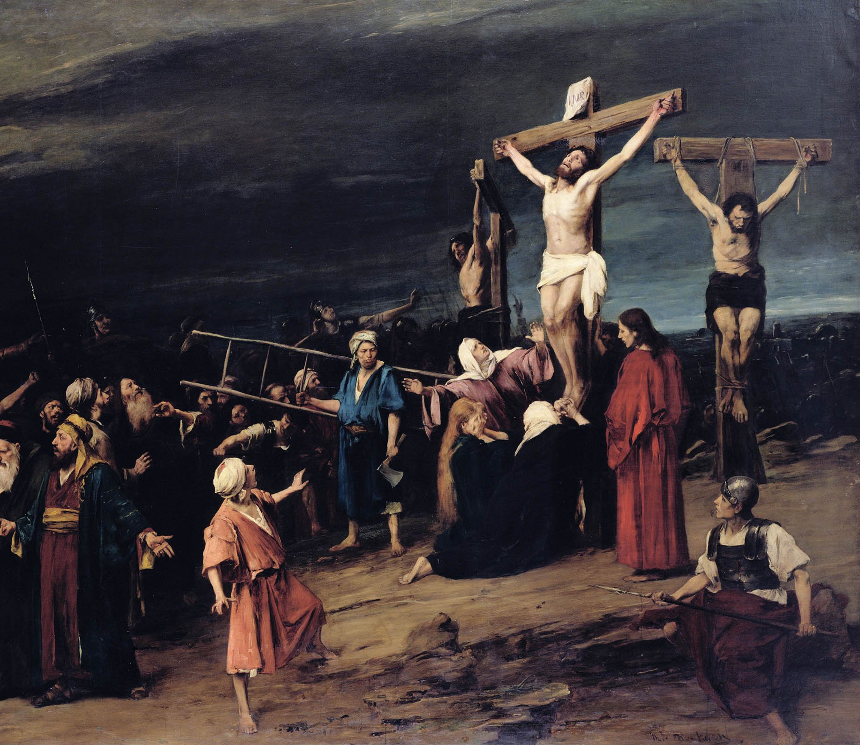
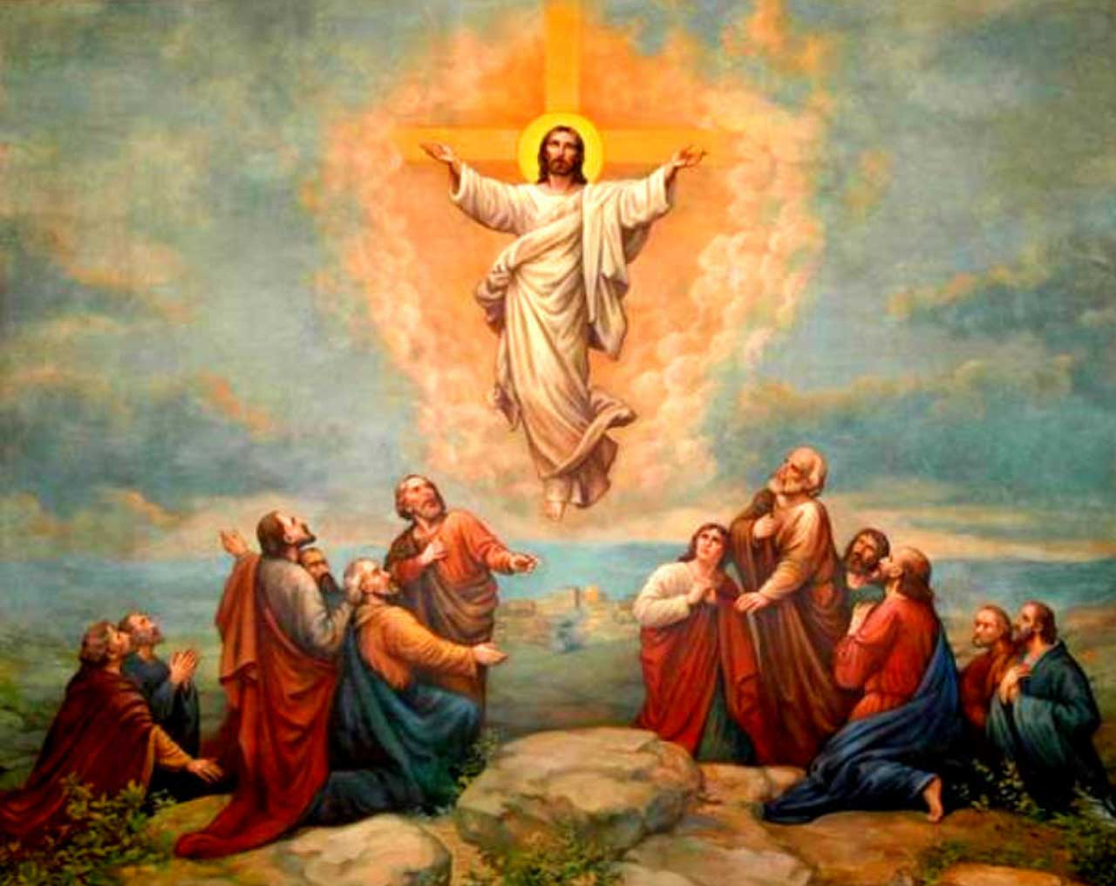

Slide 4
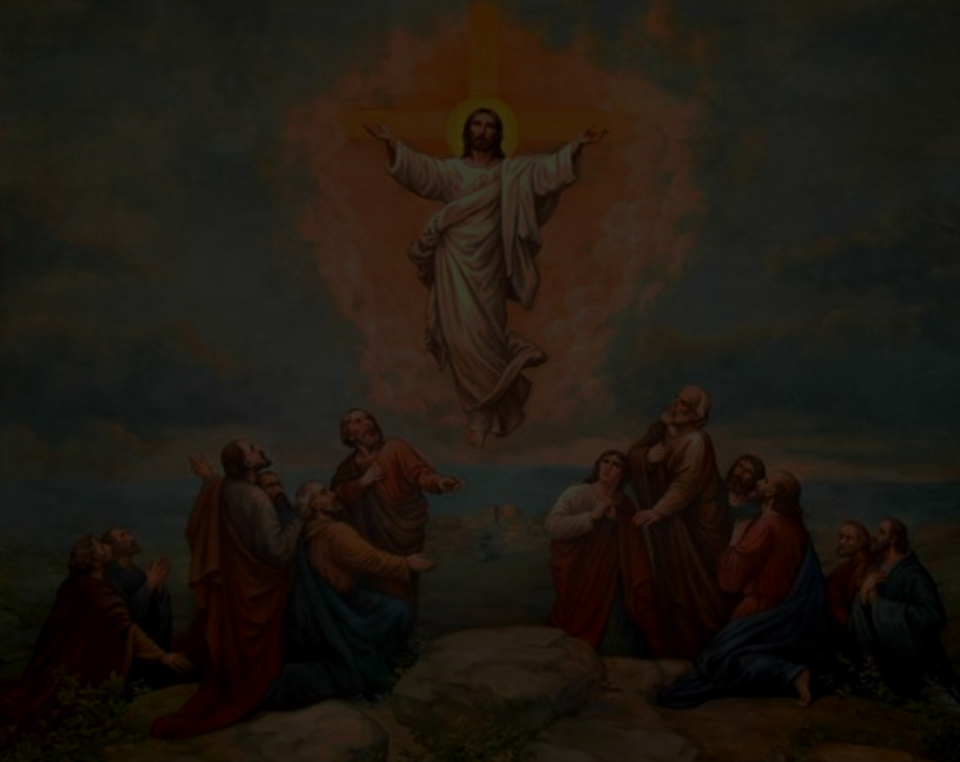

Slide 5
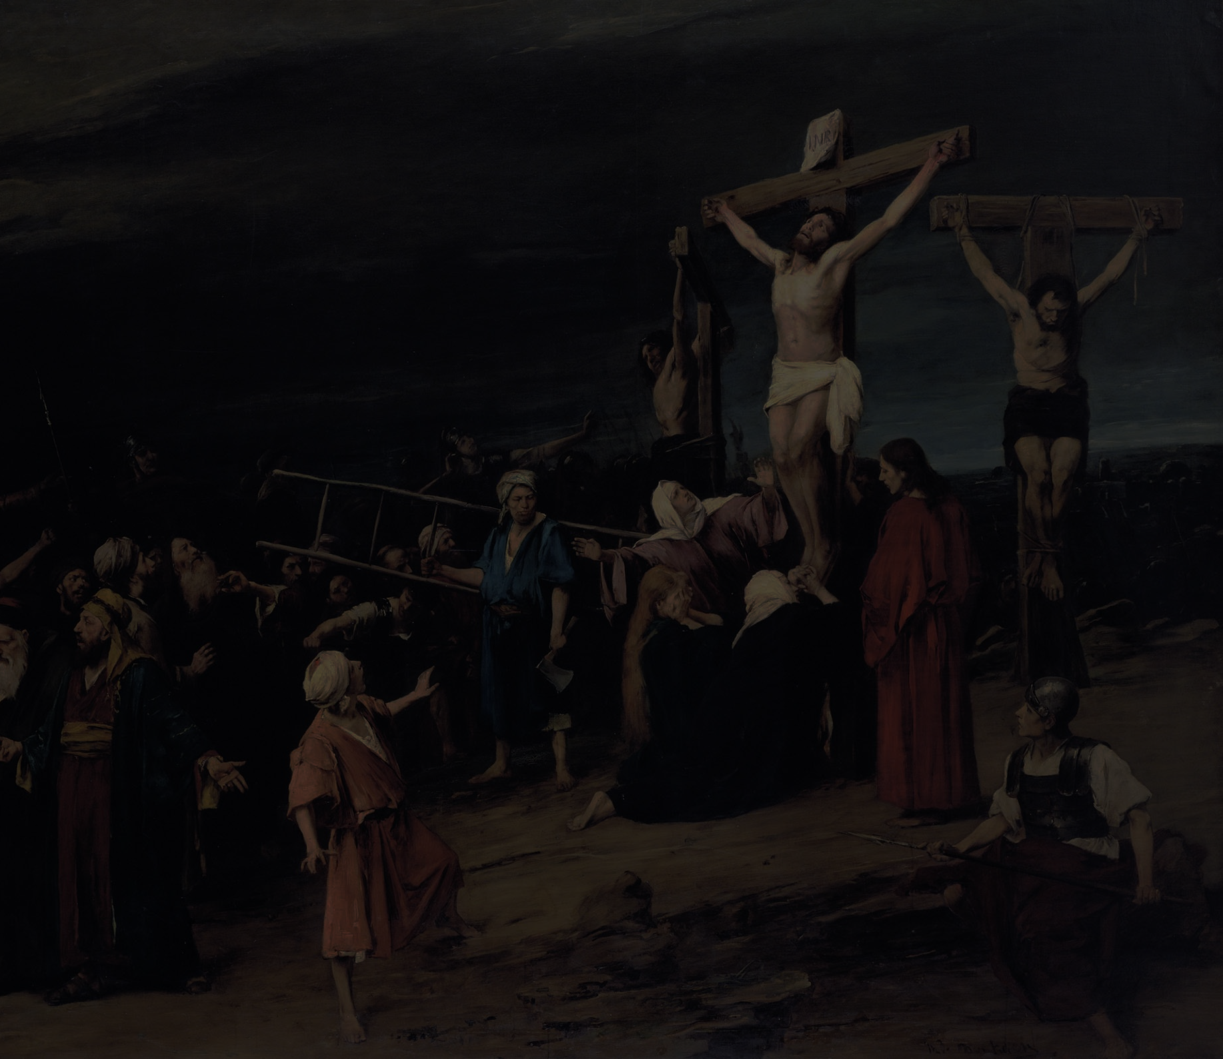

Slide 7
Ephesians 2:1, 4-6
You were dead in the trespasses and sins ... But God, being rich in MERCY, because of the great love with which he loved us, even when we were dead in our trespasses, made us alive together with Christ — by GRACE you have been saved — and raised us up with him and seated us with him in the heavenly places in Christ Jesus.

Slide 8
Mercy
To be spared from something BAD that you DESERVE.
We’ve all sinned and all deserve HELL.

Slide 9
Mercy
Psalm 51:1-2
Have mercy on me, O God, according to your steadfast love;
according to your abundant mercy blot out my transgressions.
Wash me thoroughly from my iniquity, and cleanse me from my sin!

Slide 10
Grace
To be given something GOOD that you DON’T DESERVE.
None of us deserve HEAVEN.

Slide 11
Grace
Titus 2:11
For the grace of God has appeared, bringing salvation for all people.
Ephesians 2:8
For by grace you have been saved through faith. And this is not your own doing; it is the gift of God

Slide 12
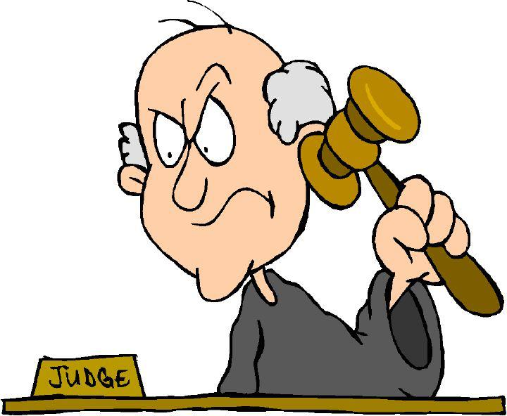

Slide 13
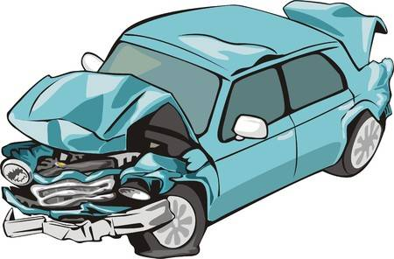


Slide 14
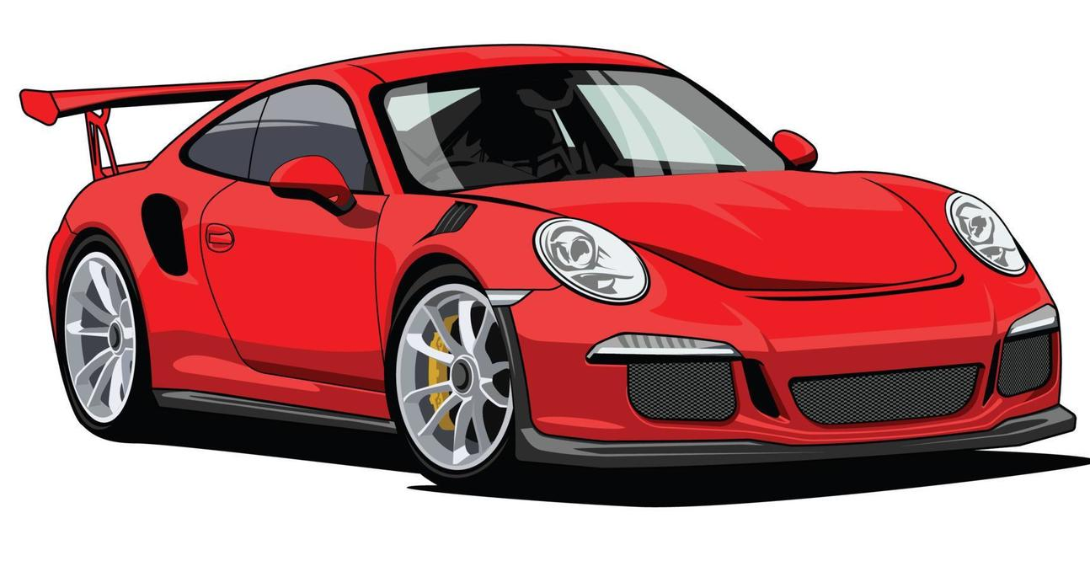
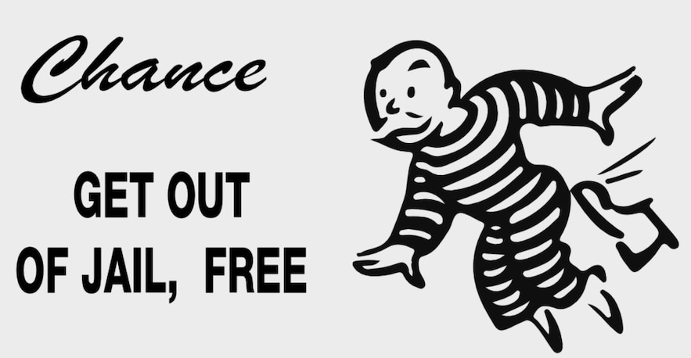

Slide 15
Acts 9 (Saul’s Conversion)
But Saul, still breathing threats and murder against the disciples of the Lord ... approached Damascus, and suddenly a light from heaven shone around him ... Although his eyes were opened, he saw nothing.

Slide 16
1 Corinthians 15:9-10a
For I am the least of the apostles, unworthy to be called an apostle, because I persecuted the church of God. But by the grace of God I am what I am.

Slide 17
Ephesians 2:1, 4-6
You were dead in the trespasses and sins ... But God, being rich in MERCY, because of the great love with which he loved us, even when we were dead in our trespasses, made us alive together with Christ — by GRACE you have been saved — and raised us up with him and seated us with him in the heavenly places in Christ Jesus.

