Slide 1

Believing the Bible

Slide 2
2 Timothy 3:16

Slide 3
Blind Faith?

Slide 4
Blind Faith?
Healthy Skepticism!

Slide 5
Blind Faith?
Healthy Skepticism!
Acts 17:11
1 John 4:1
1 Thessalonians 5:20-21

Slide 6
So, I was reading Genesis…

Slide 7
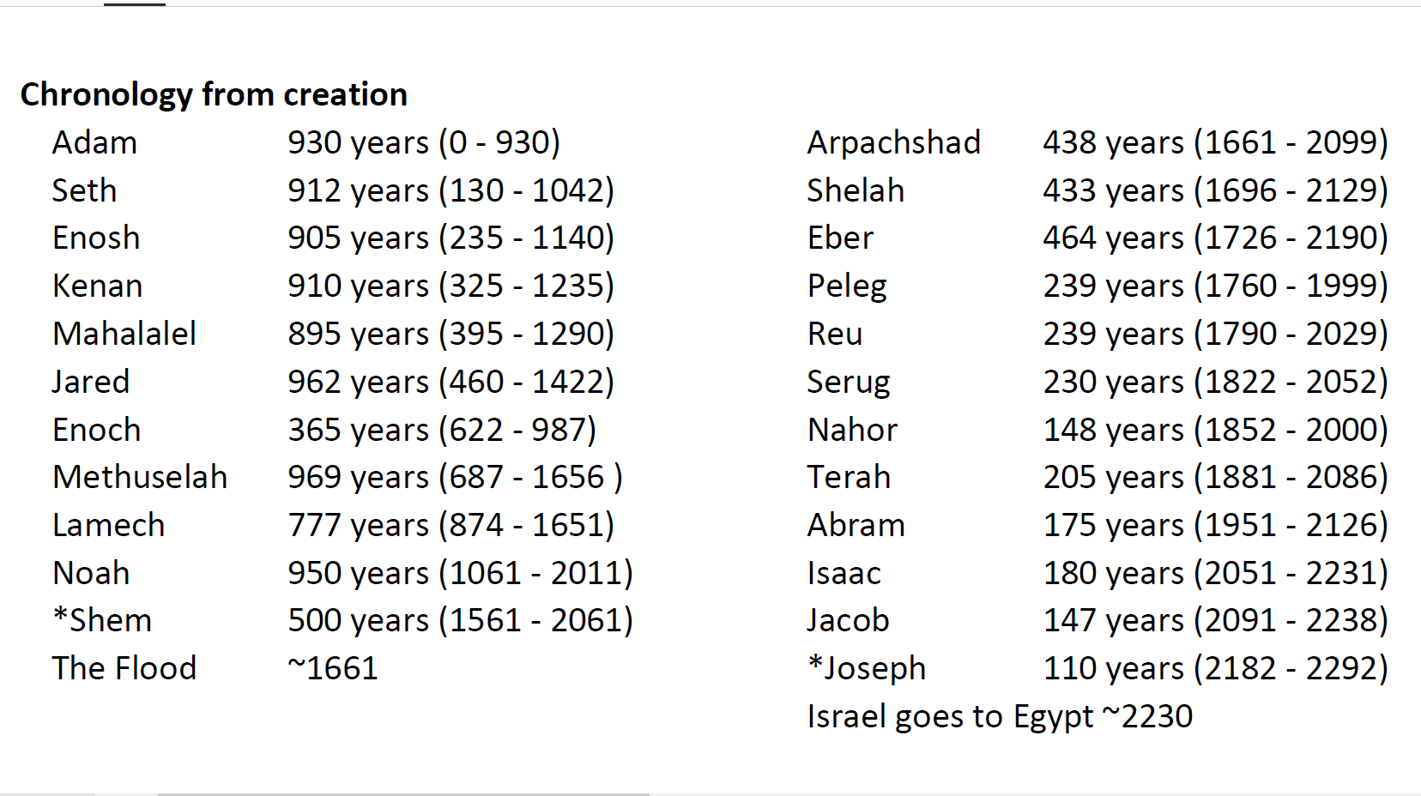

Slide 8
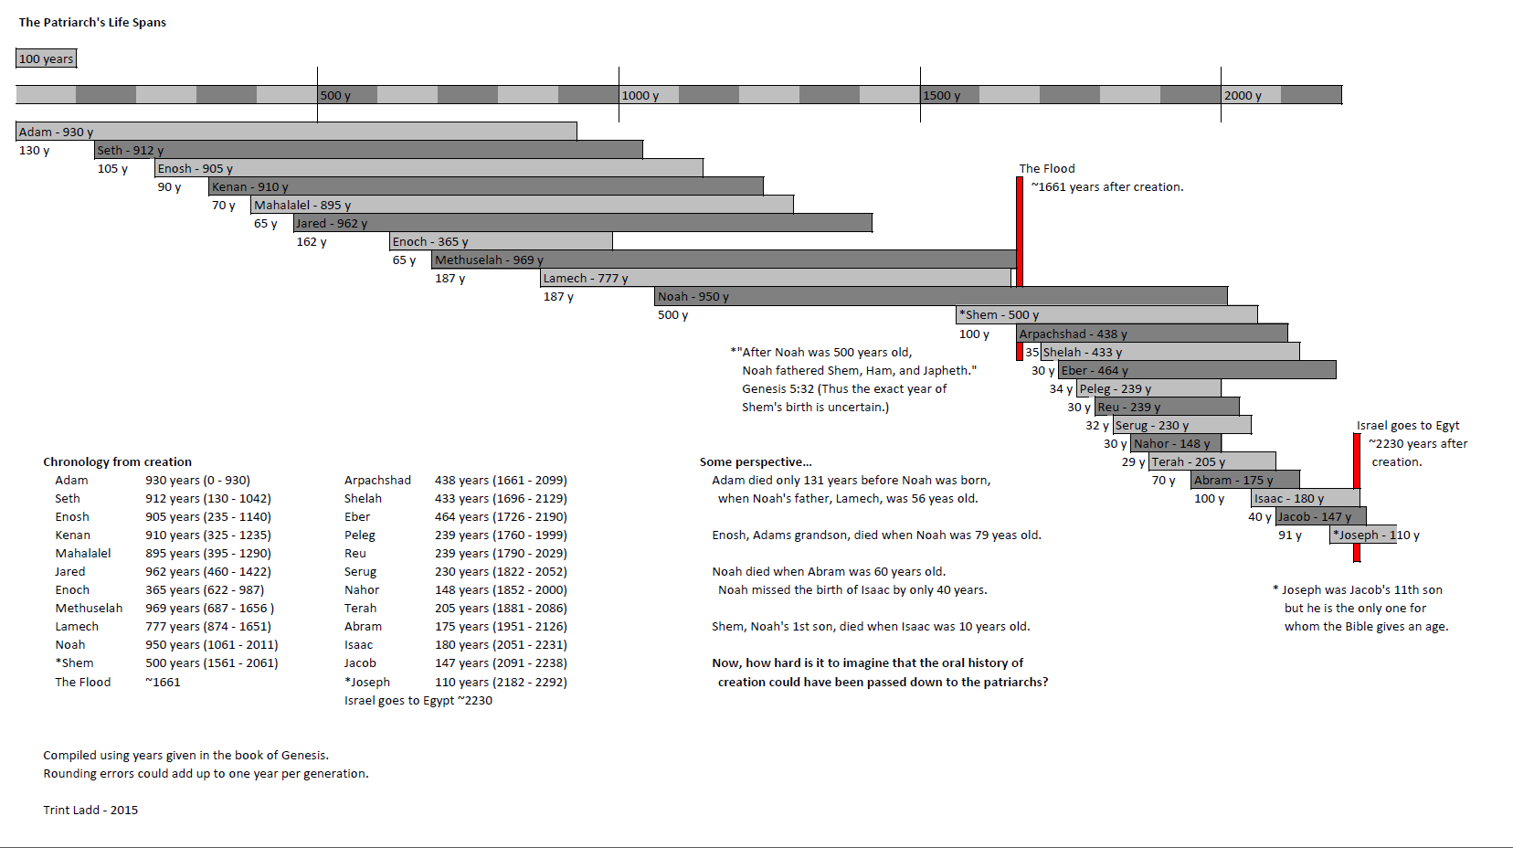

Slide 9
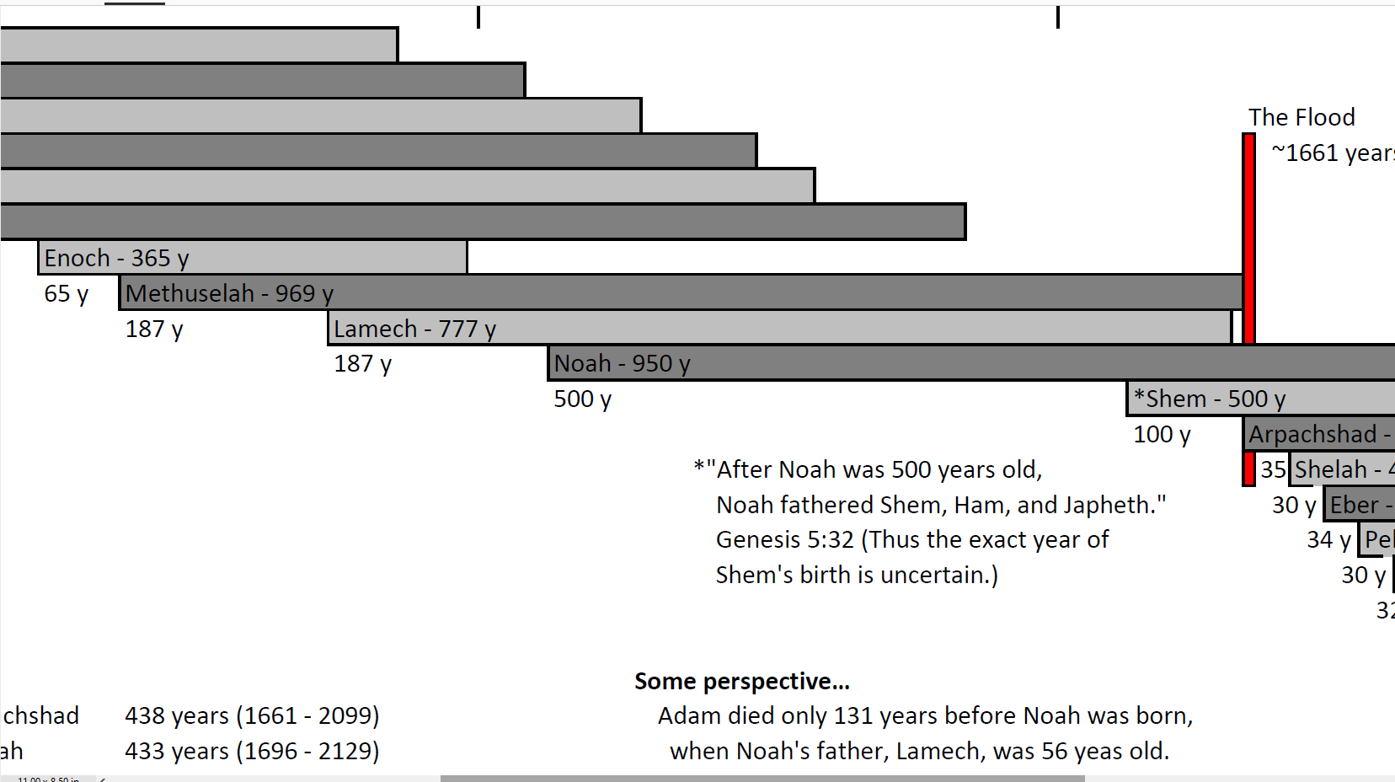

Slide 10
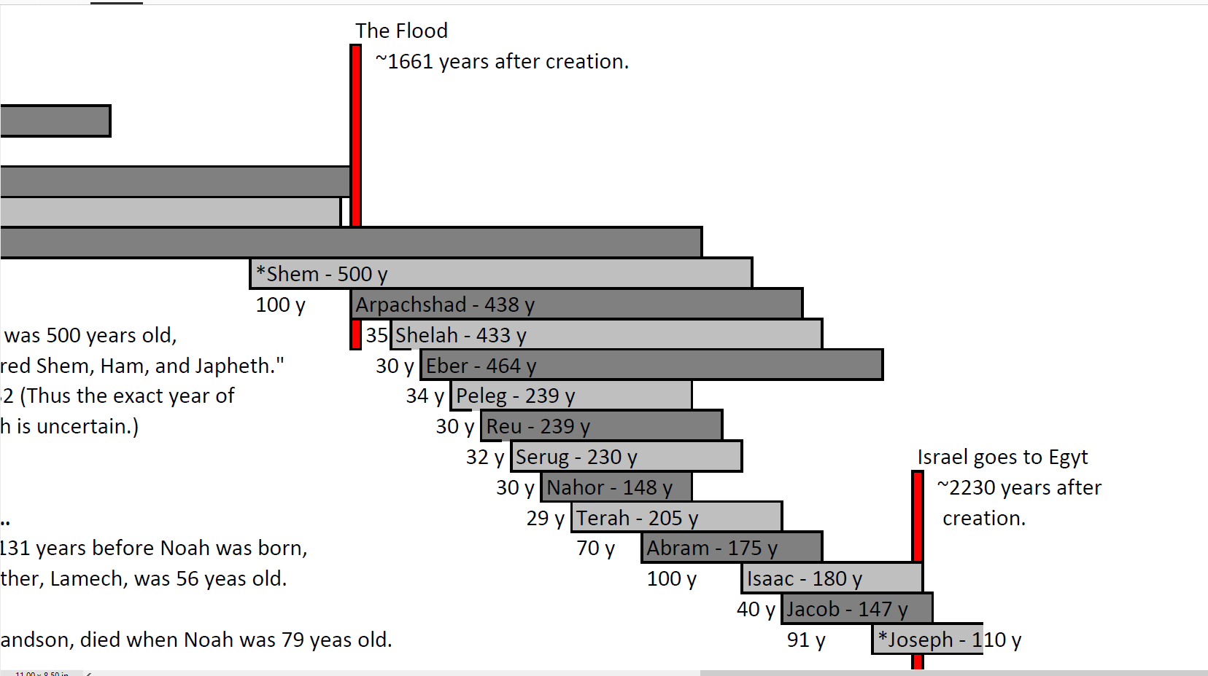

Slide 11
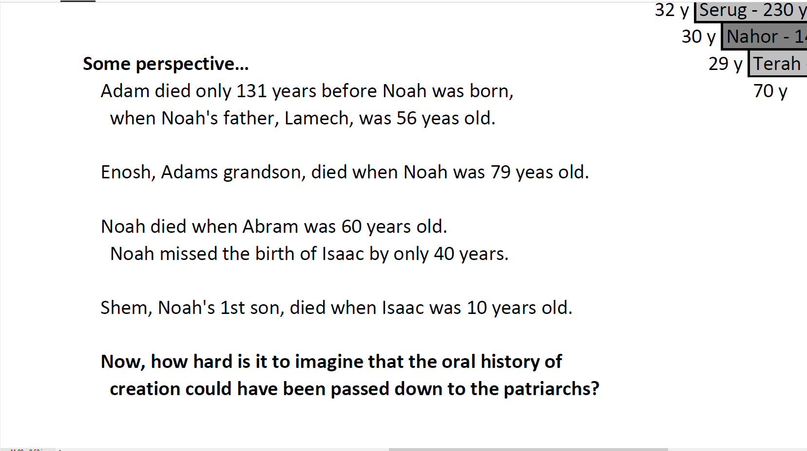

Slide 12
Then there’s
the ACTUAL books!

Slide 13
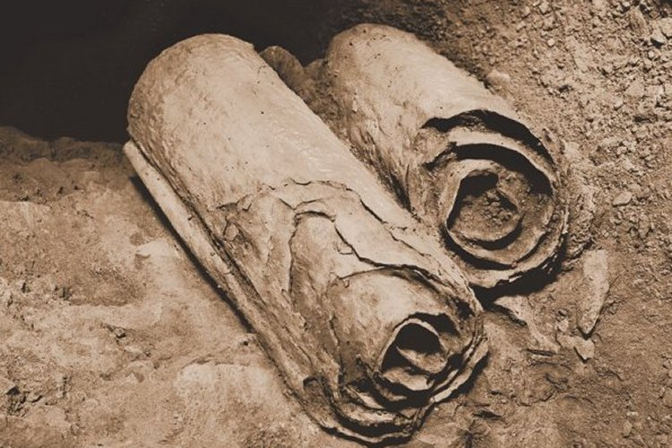
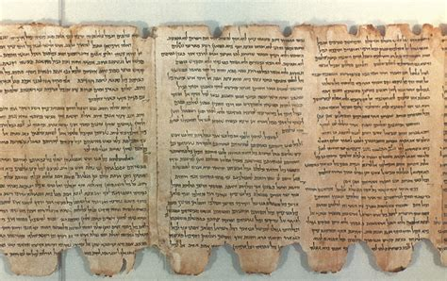
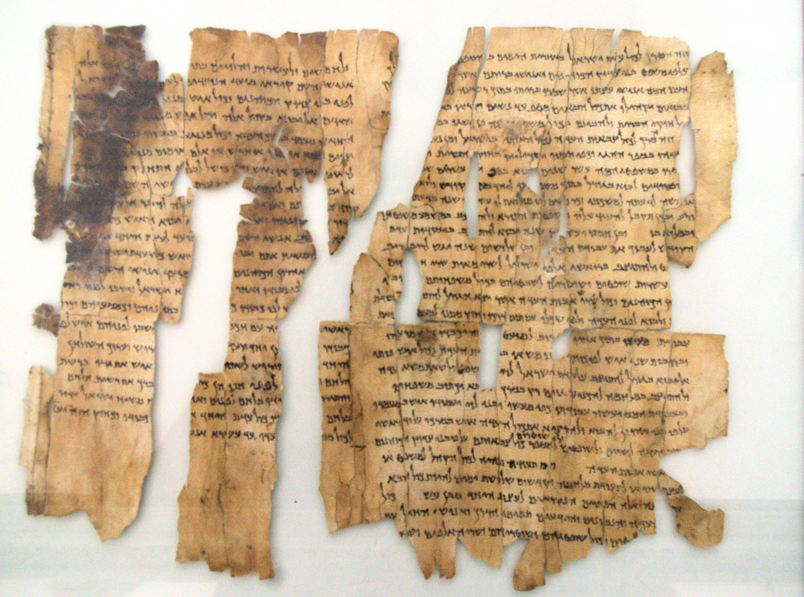
Dead Sea Scrolls

Slide 14
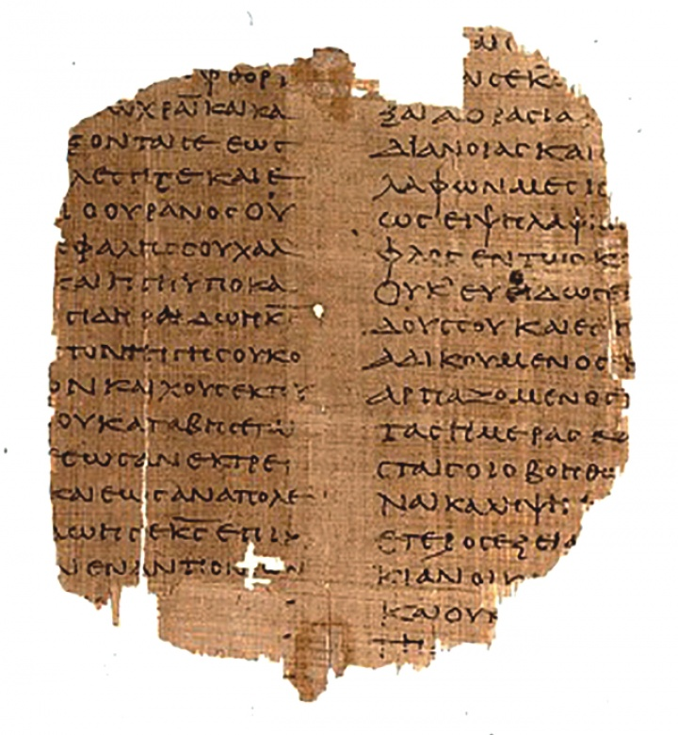
1st Century Manuscripts
Fragment of the
Gospel of Mark
Dated to approx. 90 AD

Slide 15
Unless you read ancient Hebrew,
you HAVE to translate.

Slide 16
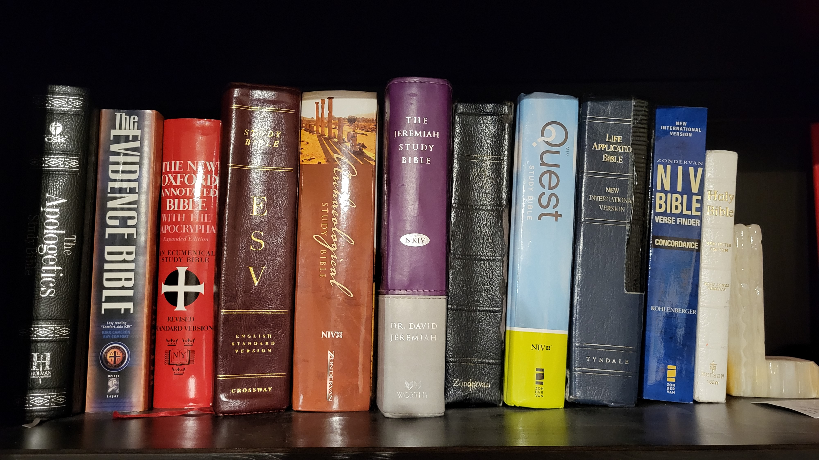
Unless you read ancient Hebrew,
you HAVE to translate.

Slide 17
“King David is a myth.”

Slide 18
“King David is a myth.”
1993 – The Tel Dan Stele
Assyrian King Hazael defeated
the “House of David”
2 Kings 10:32

Slide 19
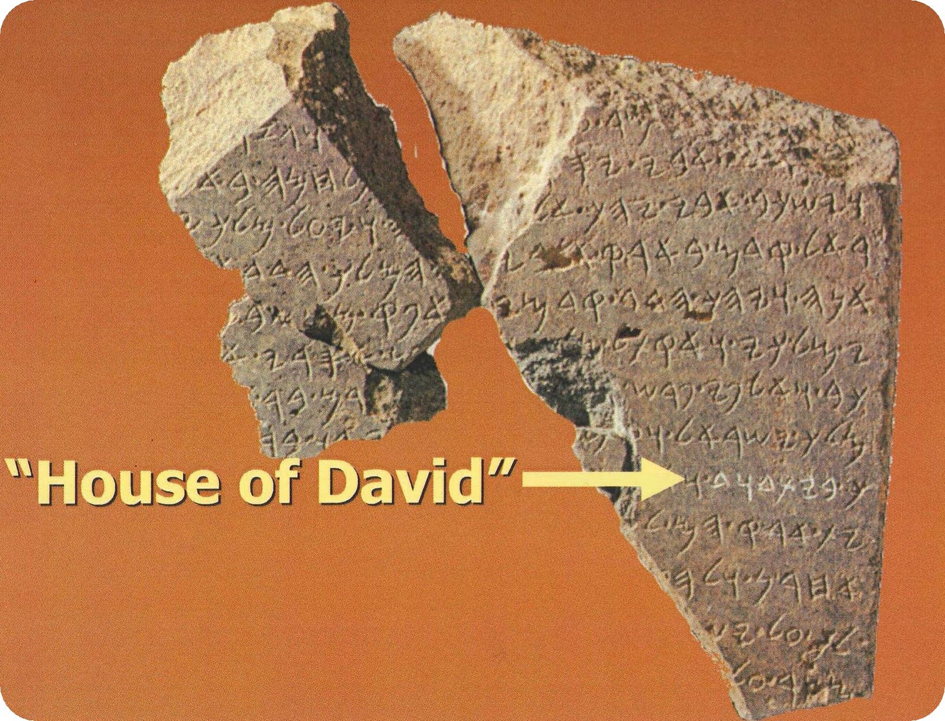

Slide 20
“Pontius Pilate is a lie.”

Slide 21
“Pontius Pilate is a lie.”
1961 – The Pilate Stone
Discovered in Caesarea,
a building dedication stone.
“Pontius Pilatus – Prefectus Judea”

Slide 22
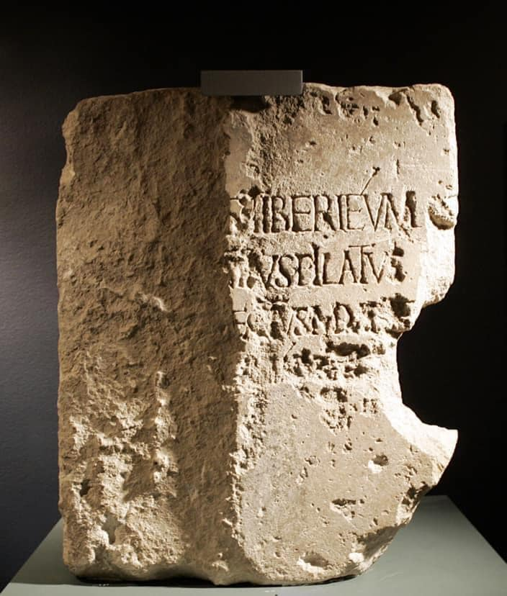

Slide 23
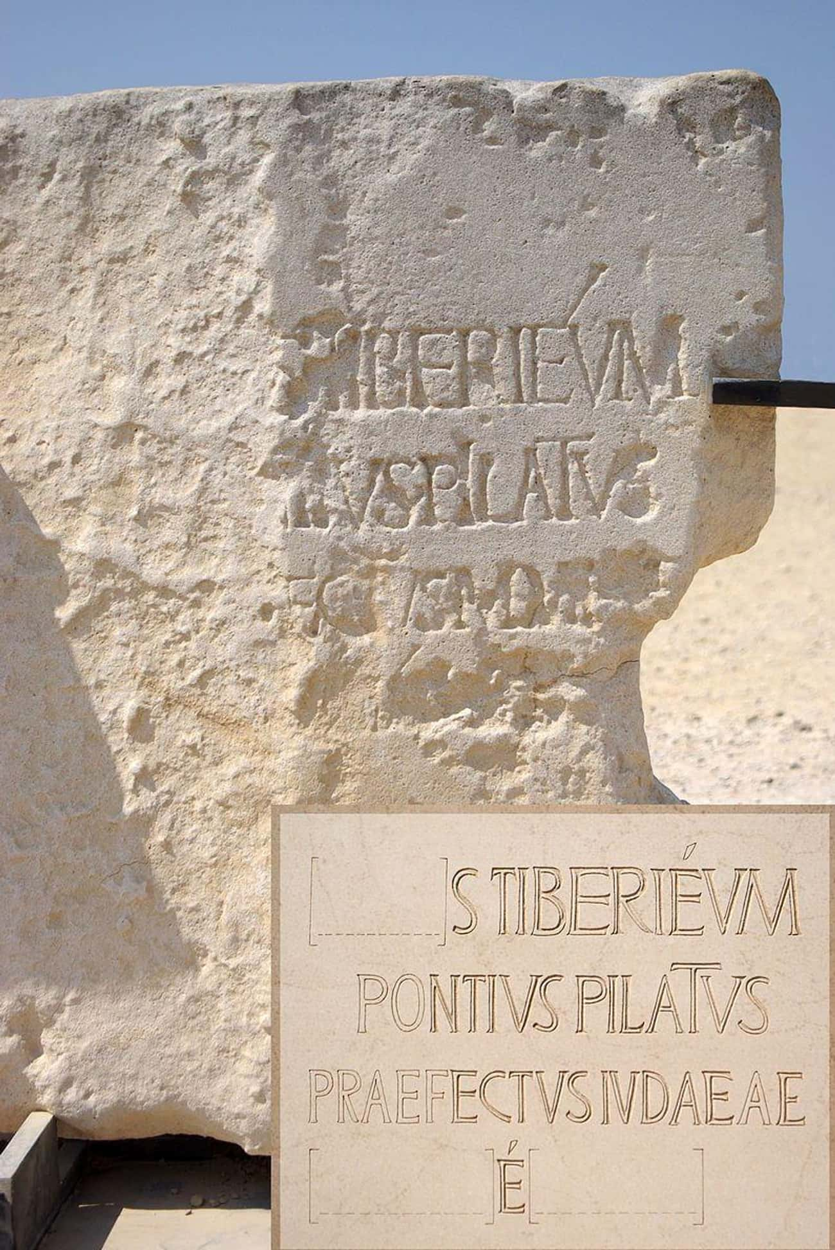

Slide 24
More every day!
2009 – Hezekiah Seal
Discovered at the Temple Mount
Official seal of King Hezekiah

Slide 25
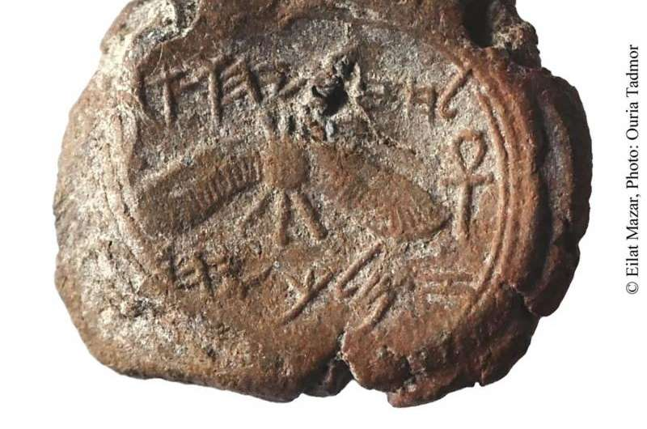
“Belonging to Hezekiah [son of] Ahaz king of Judah”
2 Kings 16:20

Slide 26
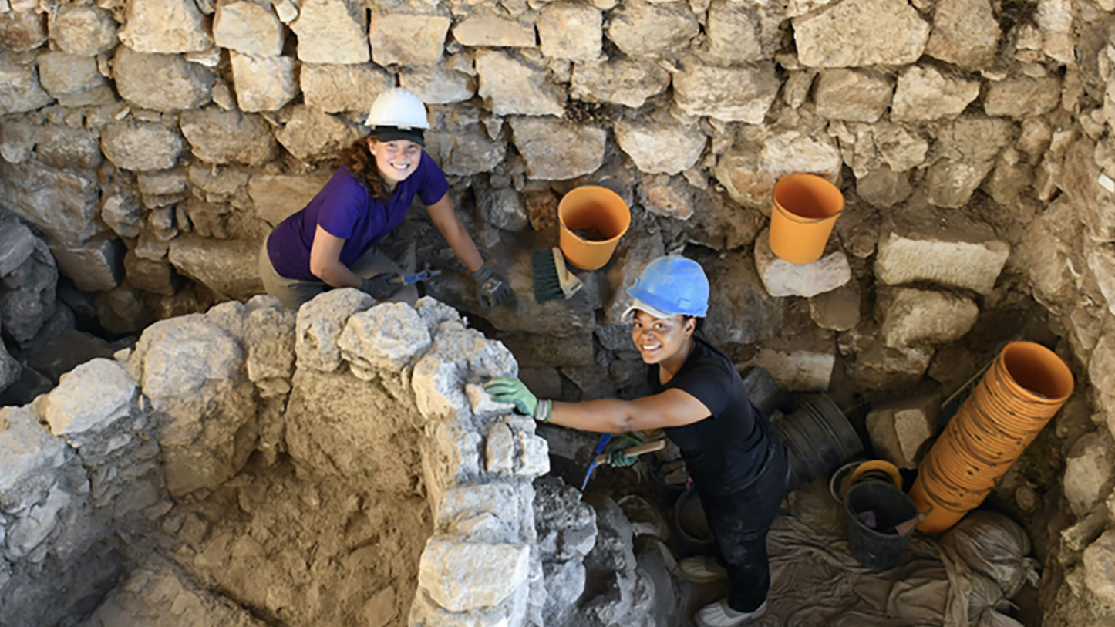

Slide 27
Believing the Bible

