Slide 1
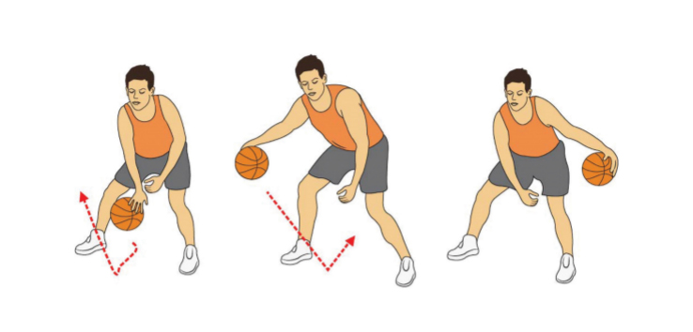
Christian Fundamentals
Part 1 – Who is God? Who is Man?

Slide 2


Slide 3
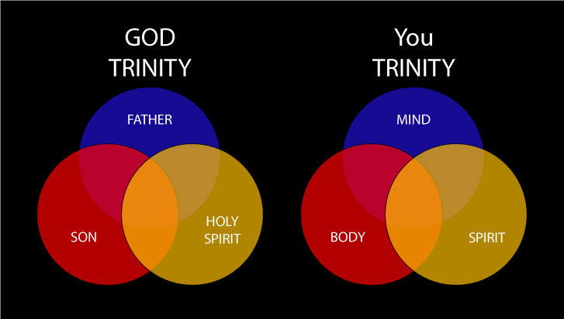

Slide 4
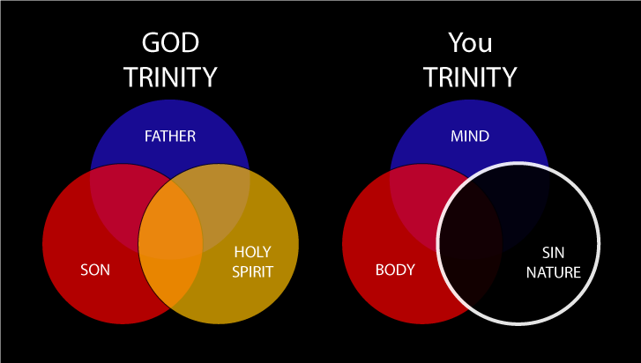

Slide 5


Slide 6
Christian Fundamentals
Part 1 – Who is God? Who is Man?

