Slide 1

Christian Fundamentals
Part 2 – What is Salvation?

Slide 2
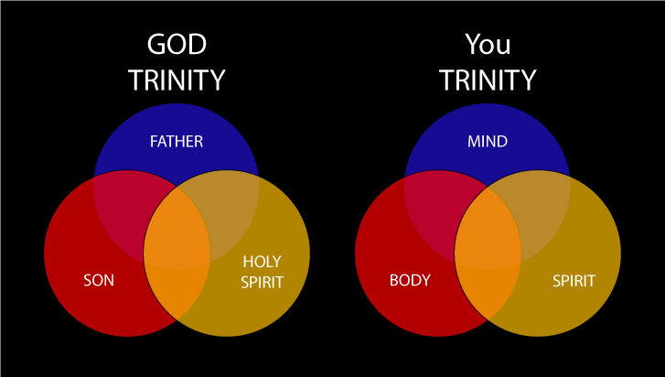

Slide 3
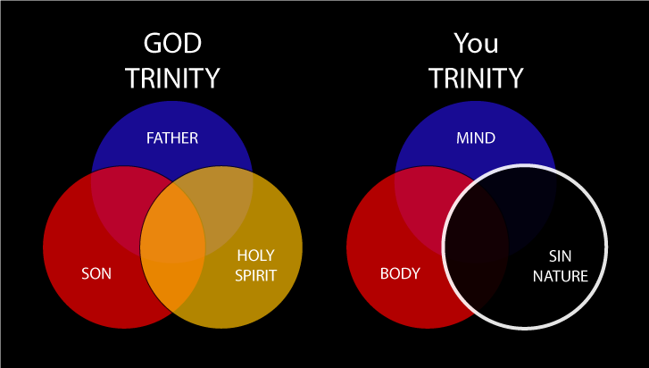

Slide 4


Slide 5
Christian Fundamentals
Part 2 – What is Salvation?

