Slide 1
The End Times
A Quick Overview of Things To Come

Slide 2
3 MOST IMPORTANT POINTS
No one knows for sure.
It is Vital to know what the Bible says.
No one knows for sure.

Slide 3
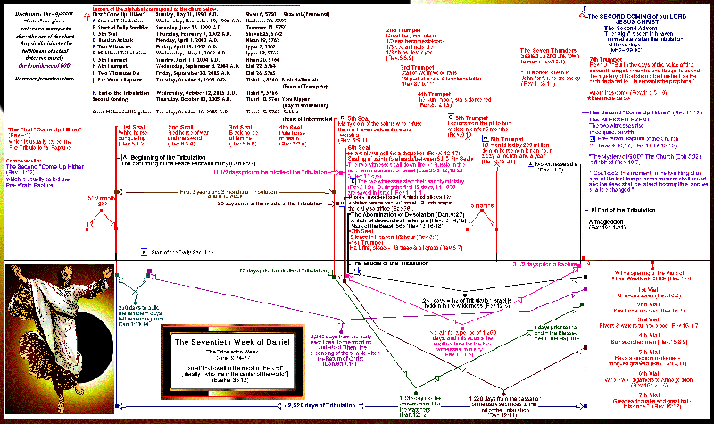

Slide 4
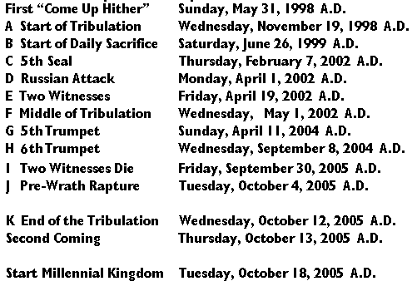

Slide 5
MAIN EVENTS
Rapture (caught up)
Tribulation (trouble)
Judgment Seat/Wedding Feast
Battle of Armageddon
Millennial Reign of Christ
White Throne Judgment
New Heaven and New Earth

Slide 6
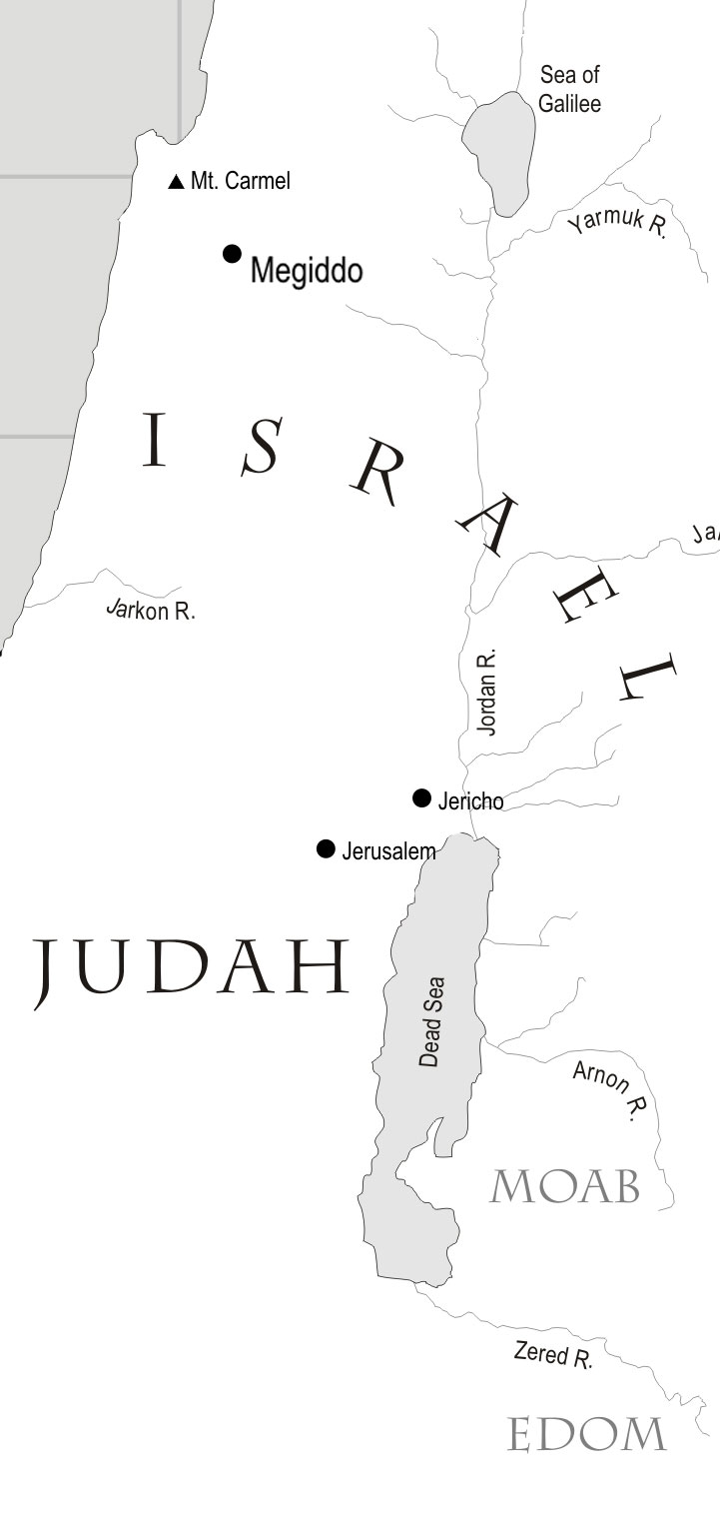
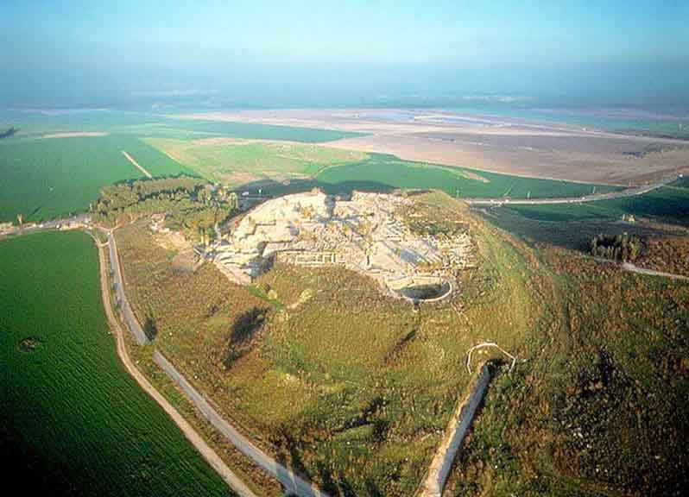

Slide 7
THE TIME LINE
Many theories…
Pre-Tribulation
Mid-Tribulation
Post-Tribulation
Post-Millennial
Amillennial
Are you confused yet?

Slide 8
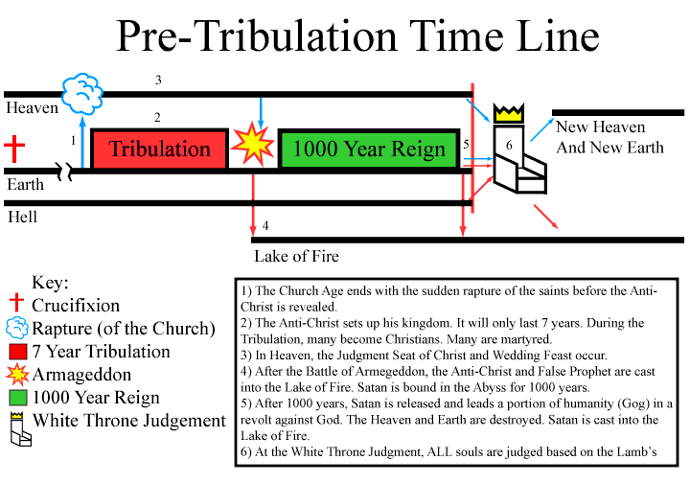

Slide 9
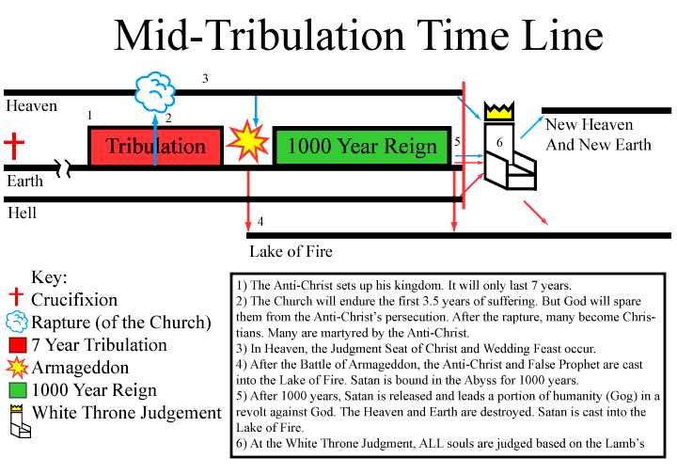

Slide 10
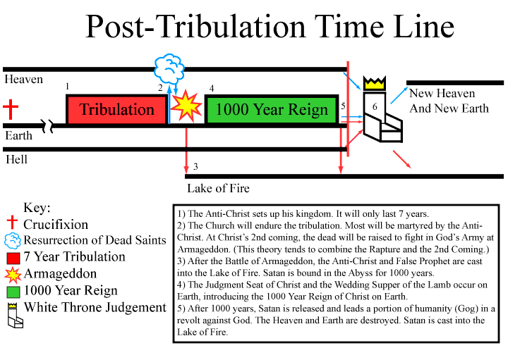

Slide 11
Pre-Millennial
Post-Millennial
  One single second coming of Christ
  One single resurrection of the dead
  The 1000 Year Reign is already in place (the Church)
Amillennial
  Same as Post-Millennial, but…
  1000 Year Reign is symbolic
  Revelation (and possibly other books) are doubted
  Bible is allegorical, not literal

Slide 12
THE ANTI-CHRIST
Oooh! Scary!
What do we know? Not as much as you might think!!
What does the Bible say?

Slide 13
Nebuchadnezzar’s Statue (Daniel 2)
Daniel’s Four Beasts (Daniel 7)
Revelation’s Unholy Trinity (Revelation 13)
Revelation’s Scarlet Beast (Revelation 17)
The Mark - 666

