Slide 1


Slide 2
Do ALL to the glory of GOD

Slide 3
Ask yourself
What is your
PURPOSE?

Slide 4
“Find the God centered, Christ exalting, Bible saturated passion of your life; find your way to live for it and die for it, you will make a difference that lasts; you will not waste your life.
– John Piper

Slide 5
Ask yourself
What is your
PURPOSE?

Slide 6
The WORLD says…
Your Purpose: Self-Gratification, Self-Glorification
To Achieve This: I am the center of my universe.
Secular Humanism
Relativism.
Existentialism.
The TRUTH is what I make it.

Slide 7
The WORD says…
GOD *IS* TRUTH!
Reality does not care what you FEEL is true.
God does not change. Truth does not change.

Slide 8
The WORD says…
John 8:31-32
So Jesus said to the Jews who had believed him, “If you abide in my word, you are truly my disciples, and you will know the truth, and the truth will set you free.”

Slide 9
The WORD says…
John 14:6
Jesus said to him, “I am the way, and the truth, and the life. No one comes to the Father except through me.

Slide 10
The WORD says…
John 16:13a
When the Spirit of Truth comes, He will guide you into all the truth…

Slide 11
Used by God vs “USED” by God

Slide 12
Used by God vs “USED” by God
“USED” – Manipulated. Taken advantage. Enslaved

Slide 13
Used by God vs “USED” by God
“USED” – Manipulated. Taken advantage. Enslaved
This is a misunderstanding of God’s character!
What God wants for us is infinitely BETTER
than anything we could do ourselves!!

Slide 14
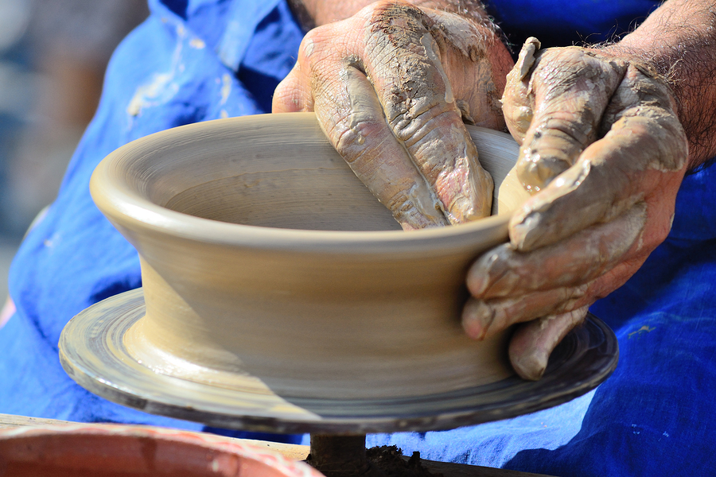
Used by God vs “USED” by God
The Potter vs the Pot
Jeremiah 18:2-6
Isaiah 64:8
Romans 9:20-21

Slide 15
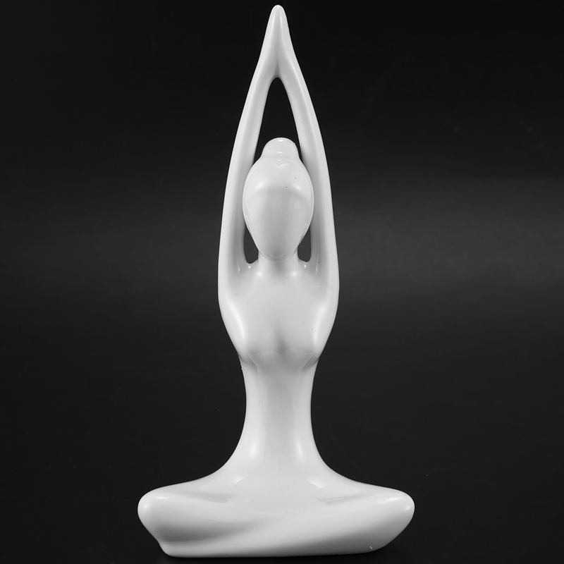
Used by God vs “USED” by God
The Potter vs the Pot

Slide 16

Used by God vs “USED” by God
The Potter vs the Pot

Slide 17
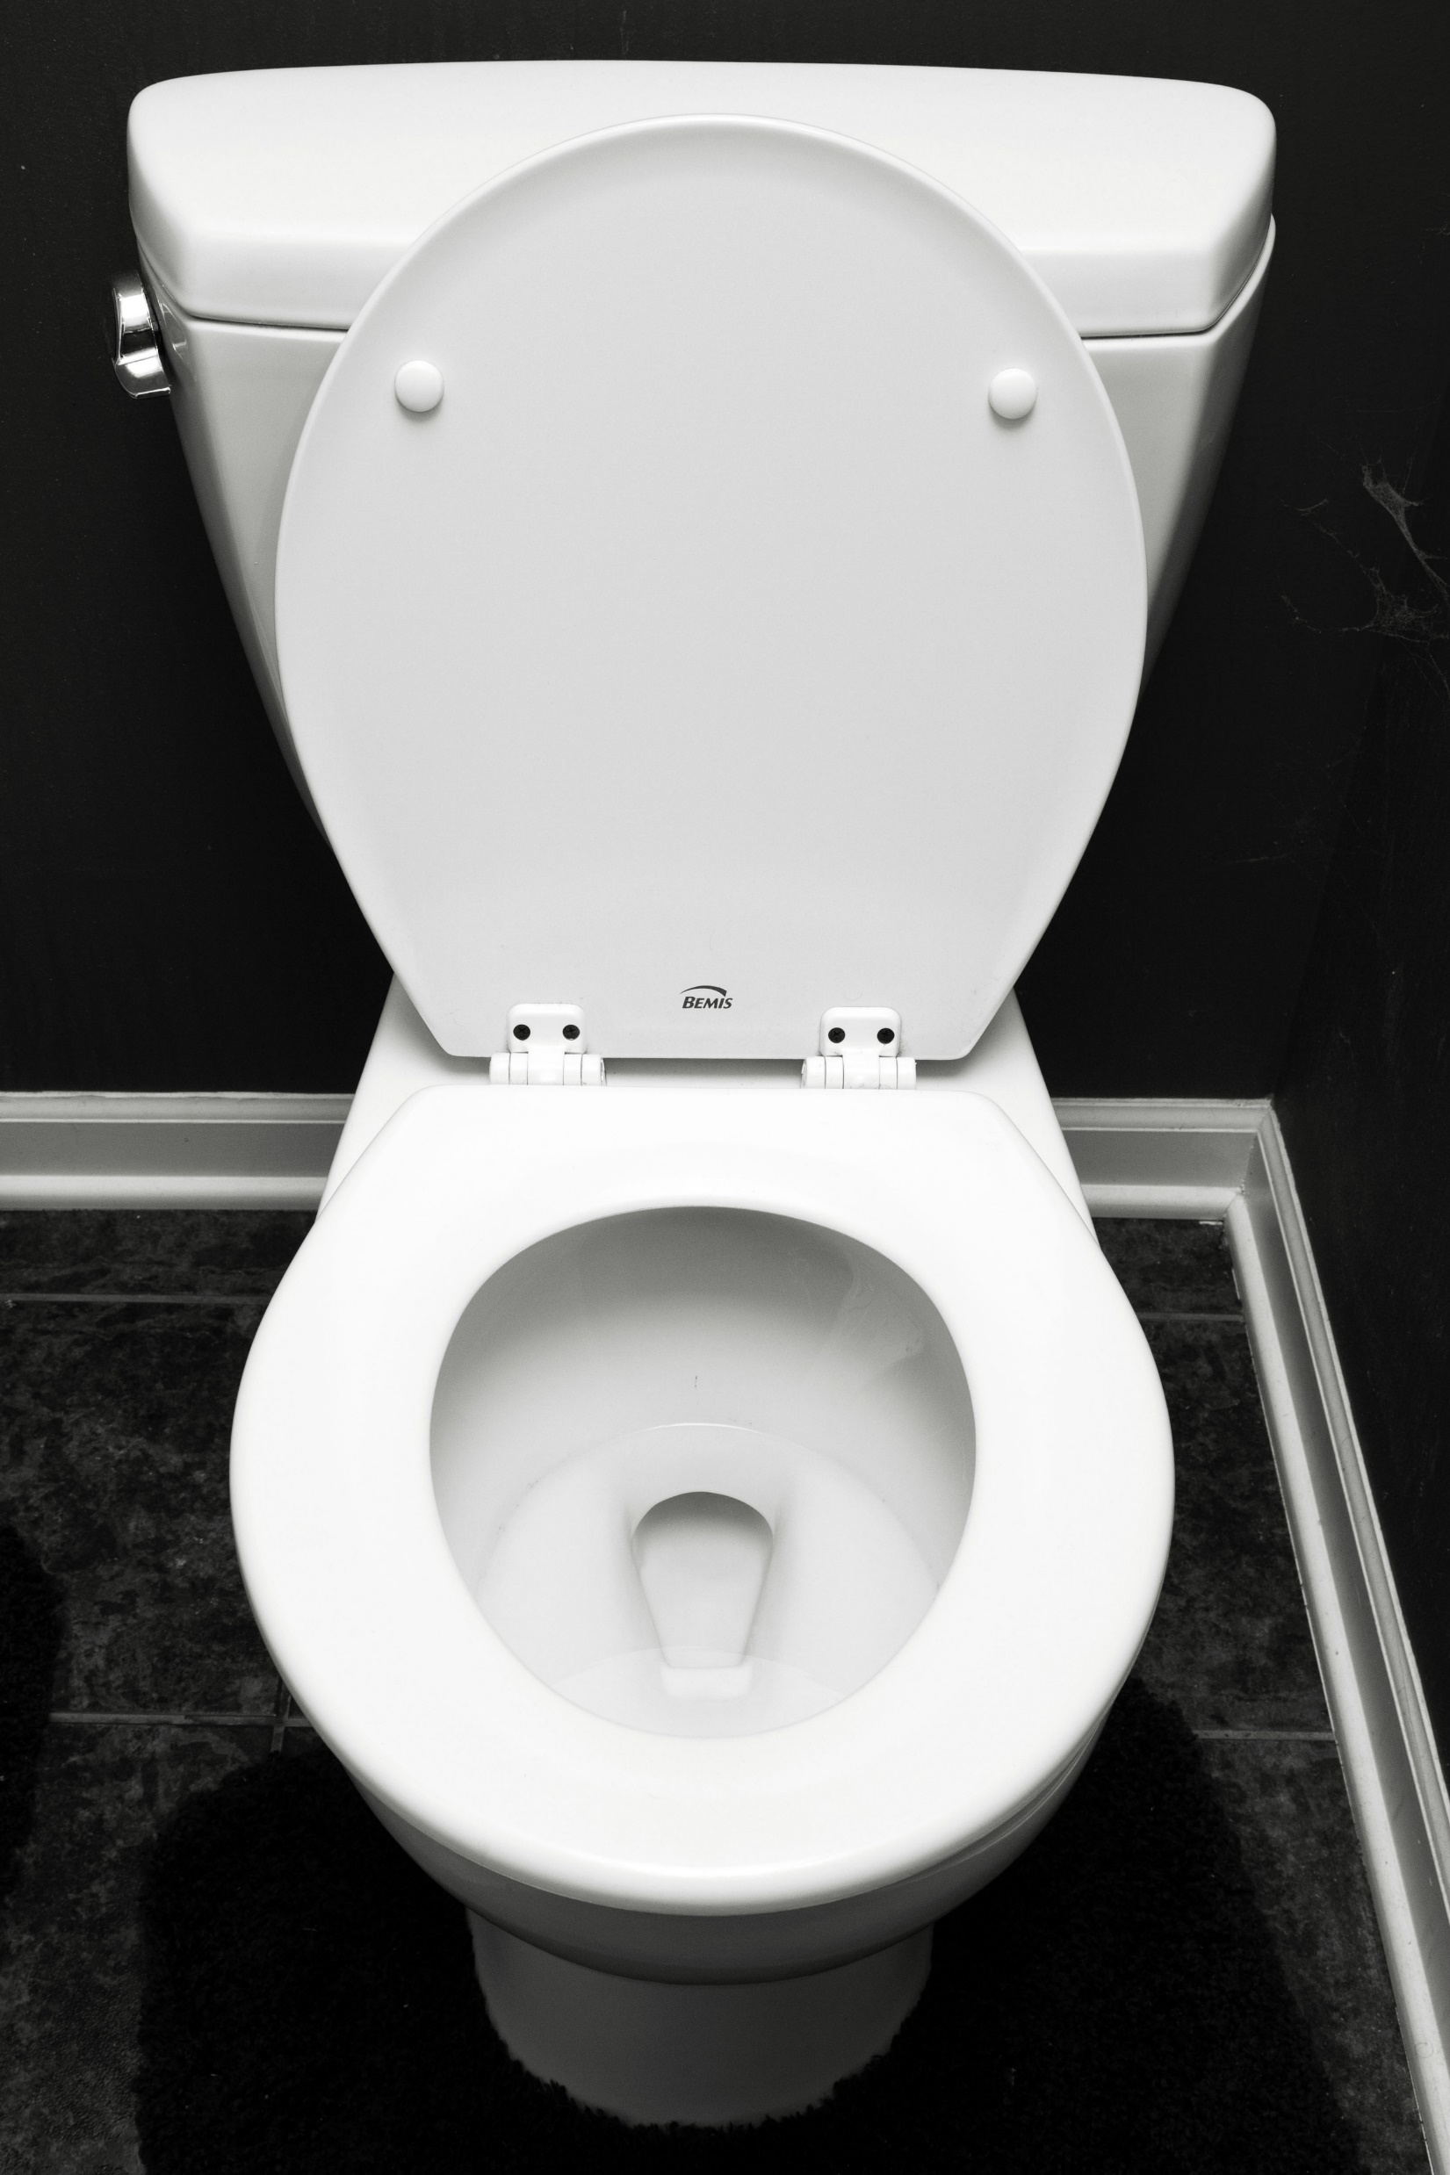
Used by God vs “USED” by God
The Potter vs the Pot

Slide 18
OK. But HOW?
1 Corinthians 10:31
Colossians 3:17
1 Peter 4:10

Slide 19
OK. But HOW?
1 Corinthians 10:31
So, whether you eat or drink, or whatever you do, do all to the glory of God.

Slide 20
OK. But HOW?
1 Corinthians 10:31
So, whether you eat or drink, or whatever you do, do all to the glory of God.
“All” means all!

Slide 21
OK. But HOW?
Colossians 3:17
And whatever you do, in word or deed, do everything in the name of the Lord Jesus, giving thanks to God the Father through him.

Slide 22
OK. But HOW?
Colossians 3:17
And whatever you do, in word or deed, do everything in the name of the Lord Jesus, giving thanks to God the Father through him.
Do your DEEDS glorify God?

Slide 23
OK. But HOW?
1 Peter 4:10
As each has received a gift, use it to serve one another, as good stewards of God's varied grace.
Use what God gave you to do HIS WORK!

Slide 24
Do ALL to the glory of GOD

