Slide 2
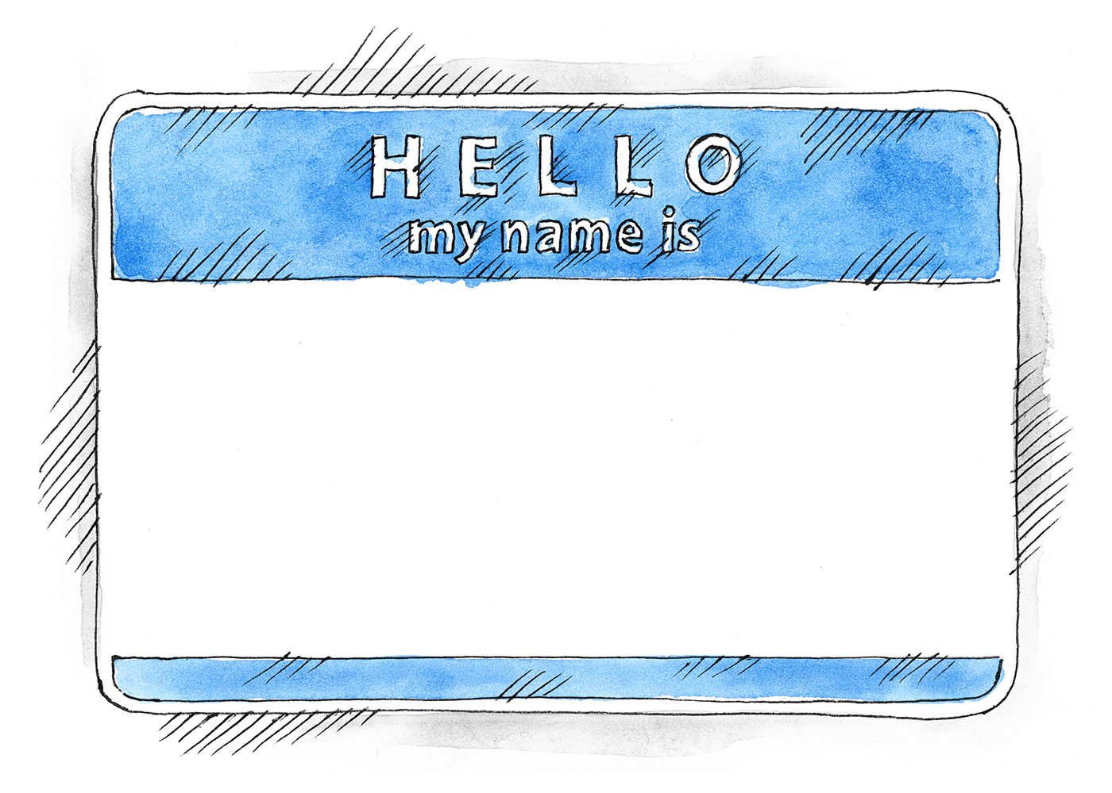
WHO ARE YOU??

Slide 3
JACOB

Slide 4
JACOB
“Heel Grabber”
“Trickster”
“Con man”

Slide 5
Gen 32:13-15, 20
…From what he had with him he took a present for his brother Esau, two hundred female goats and twenty male goats, two hundred ewes and twenty rams, thirty milking camels and their calves, forty cows and ten bulls, twenty female donkeys and ten male donkeys.
…For he thought, “I may appease him with the present that goes ahead of me… Perhaps he will accept me.”

Slide 6
Gen 32:22-23
The same night he arose and took his two wives, his two female servants, and his eleven children, and crossed the ford of the Jabbok. He took them and sent them across the stream, and everything else that he had.

Slide 7
Gen 32:24
And Jacob was left alone…

Slide 8
Gen 32:24-26
And Jacob was left alone. And a man wrestled with him until the breaking of the day. When the man saw that he did not prevail against Jacob, he touched his hip socket, and Jacob's hip was put out of joint as he wrestled with him. Then he said, “Let me go, for the day has broken.” But Jacob said, “I will not let you go unless you bless me.”

Slide 9
Gen 32:27
And he said to him, “What is your name?”
And he said…

Slide 10
JACOB
“Heel Grabber”
“Trickster”
“Con man”

Slide 11
Gen 32:28
Then he said, “Your name shall no longer be called Jacob, but Israel, for you have striven with God and with men, and have prevailed.”

Slide 12
ISRAEL
“Strives with God”
(Fight, struggle, wrestle)
Also, “God Rules”

Slide 13
WHO ARE YOU??

